Slide 1
HealthCare System
Group No:- 85
Project Guide:- Jalpa Khamar
Member 1:- Divy Patel [Enrollment No: 220SBECE30014]
Member 2:- Kishan Patel [Enrollment No: 220SBECE30018]

Slide 2
Abstract
Generally, the process of getting Doctor Appointment is time consuming.
The Patient needs to visit the Doctor’s Clinic and there also they have to travel a long distance and wait for a long queses.
So, the main purpose of this application is to provide the online Doctor Appointment and Lab Test Appointment.
The purpose of the project is to built an application program to reduce the manual work for managing Doctor Appointment and Lab Test.

Slide 3
Functional Requirements
Patients:-
Patient can Register and Login.
Patient can See Doctor’s List & Details.
Patient can Book Appointment for Specific Doctor.
Patient can See Lab’s List & Details.
Patient can Book Appointment for Specific Lab.
Patient can check Reports of Previous Appointments.
Patient can See List of Appointment that patient Booked.

Slide 4
Doctor :-
Doctor can Register and Login (After Admin’s Approval).
Doctor can See the List of Appointment and Approve/Reject it.
Doctor can see the List of Today’s Appointment.
Doctor can Share the Specific Report of the Appointment.

Slide 5
Lab Manager:-
Lab Manager can Register and Login (After Admin’s Approval).
Lab Manager can See the List of Appointment and Approve/Reject it.
Lab Manager can see the List of Today’s Appointment.
Lab Manager can Share the Specific Report of the Appointment.

Slide 6
Admin:-
Admin can Login.
Admin can Approve/Reject the Doctors.
Admin can Approve/Reject the Lab Manager.
Admin can See the List of Doctors and Lab Manager.

Slide 7
Use Case Diagram

Slide 8
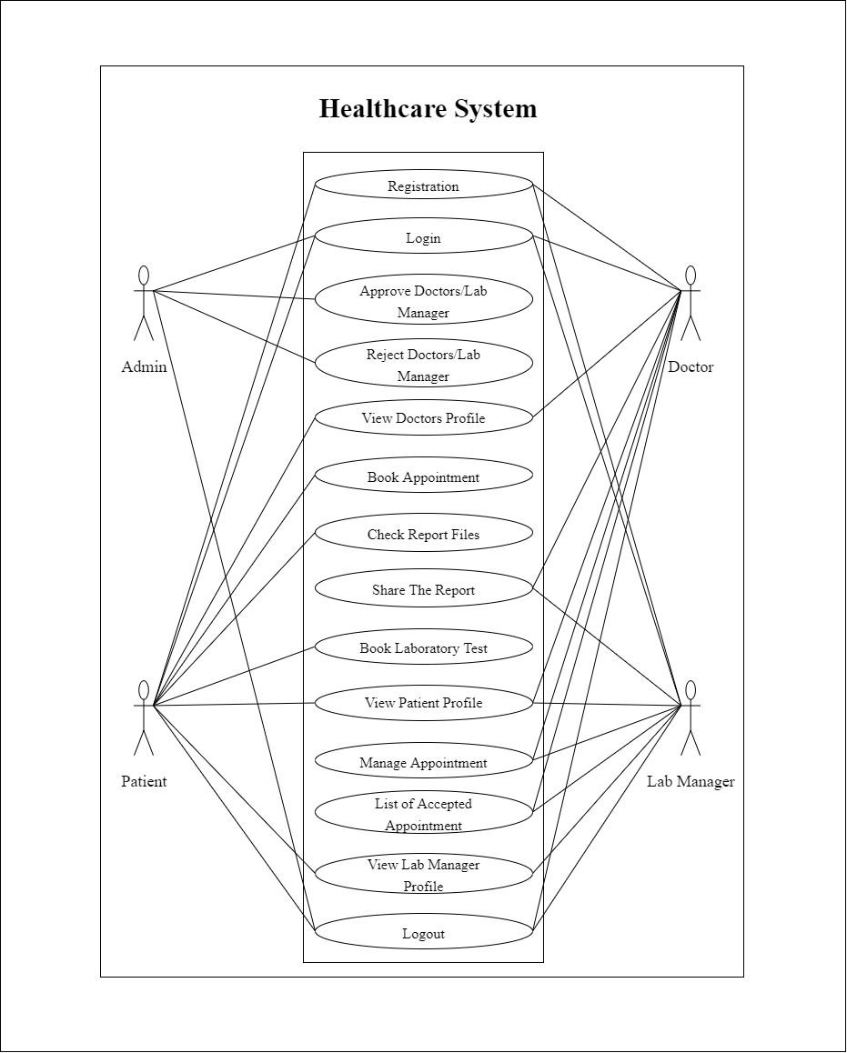

Slide 9
Activity Diagram

Slide 10
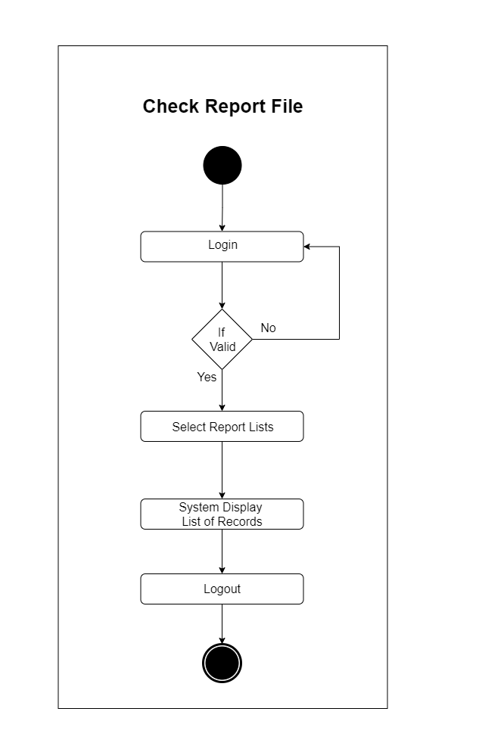
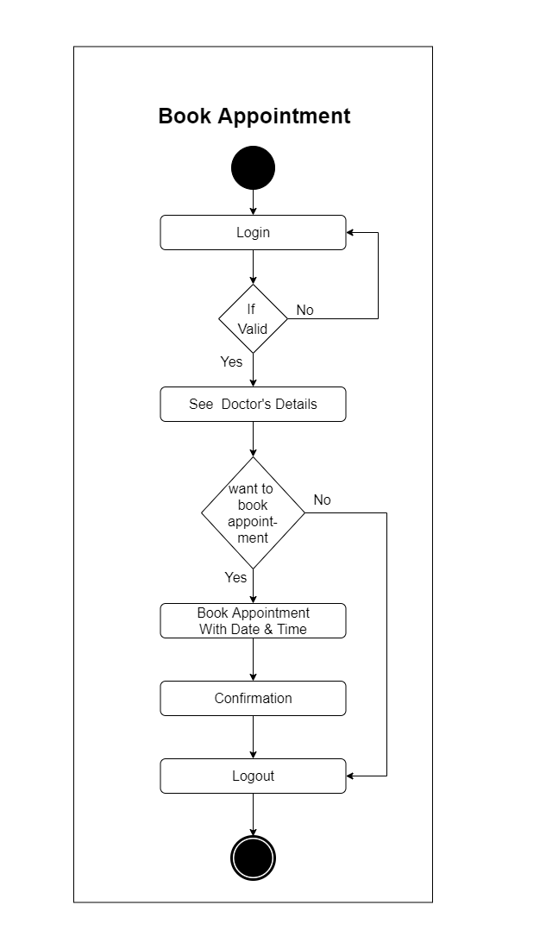
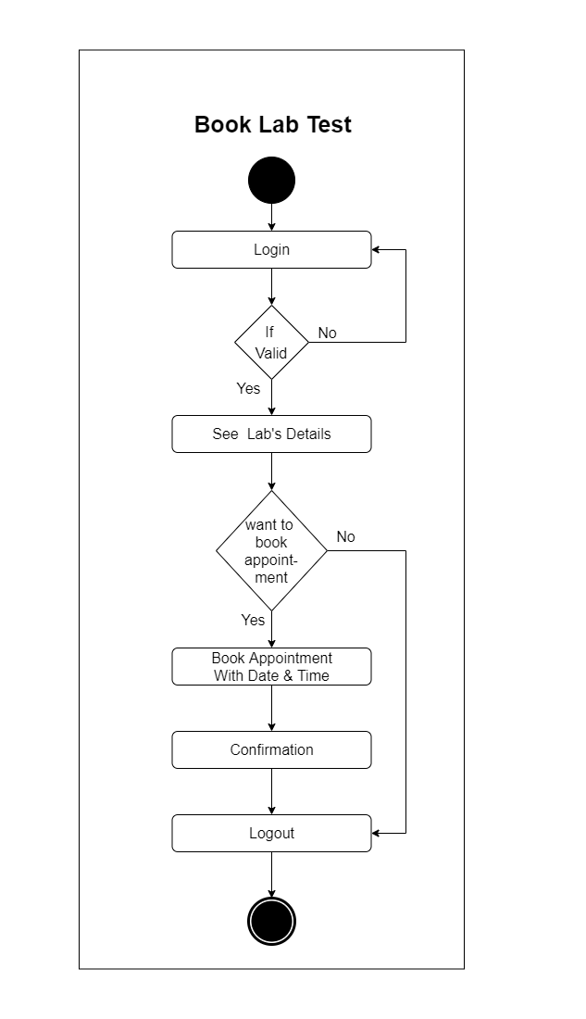

Slide 11

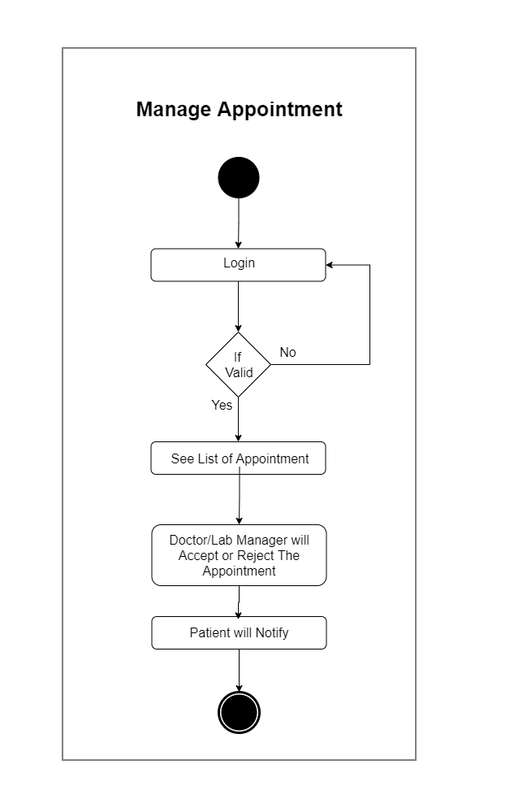
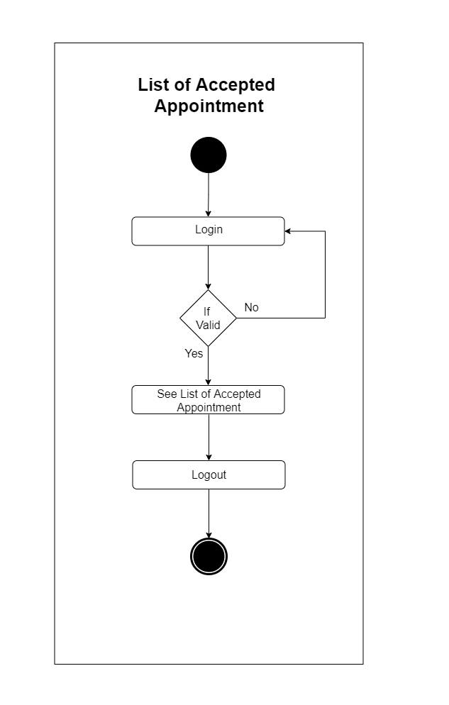

Slide 12
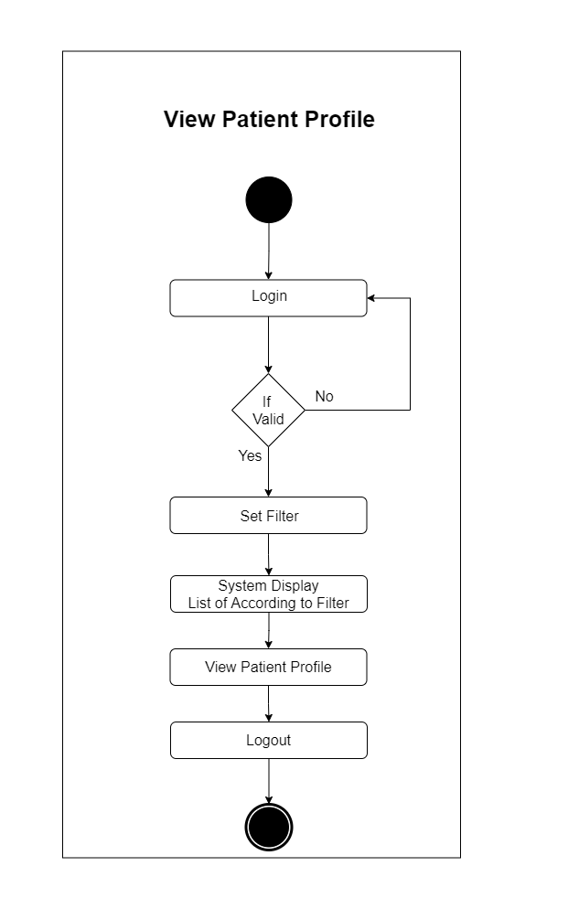

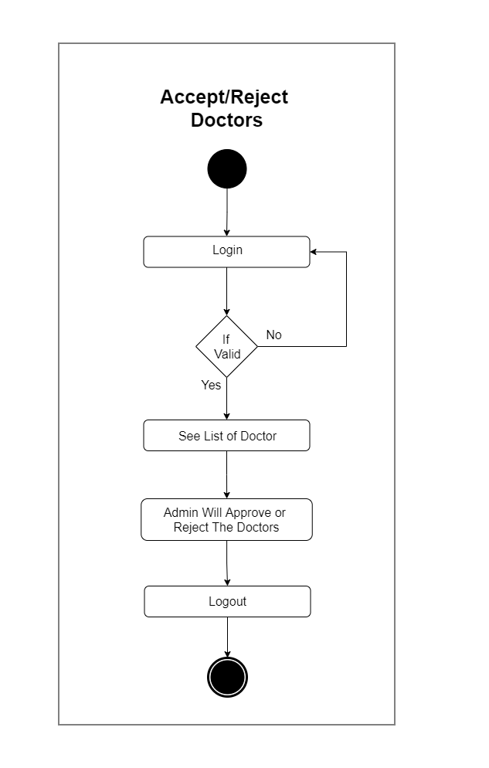

Slide 13
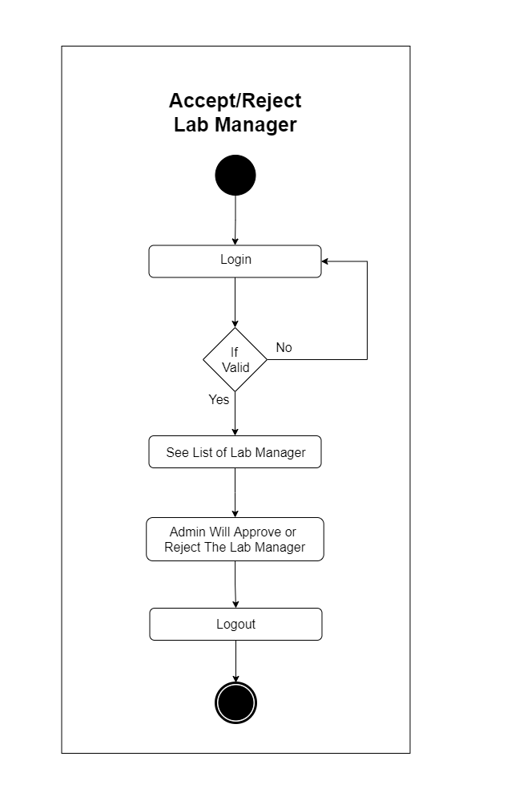


Slide 14
DFD Level 0 Diagram

Slide 15
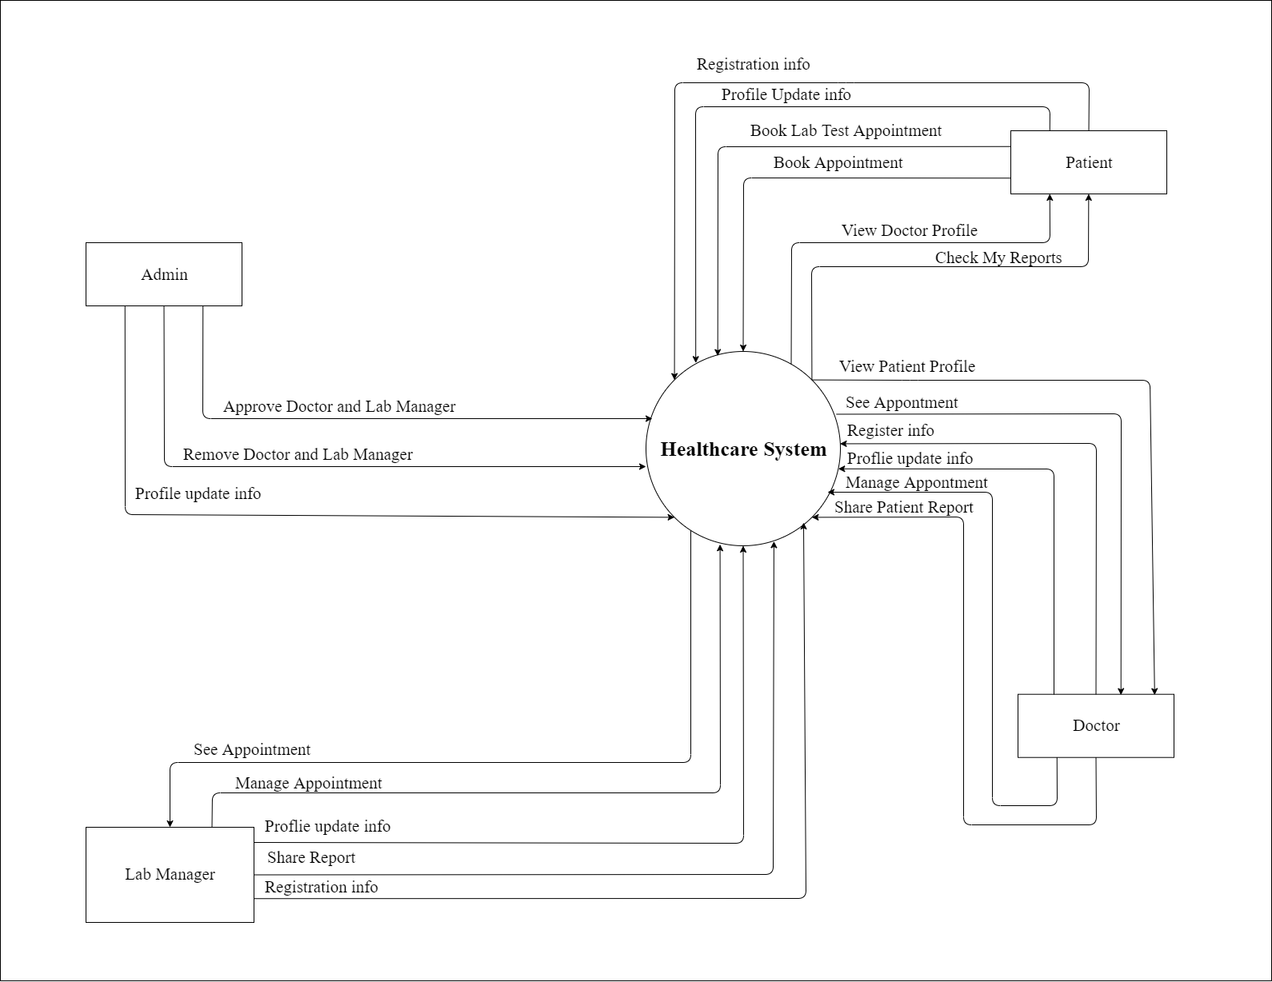

Slide 16
DFD Level 1 Diagram

Slide 17
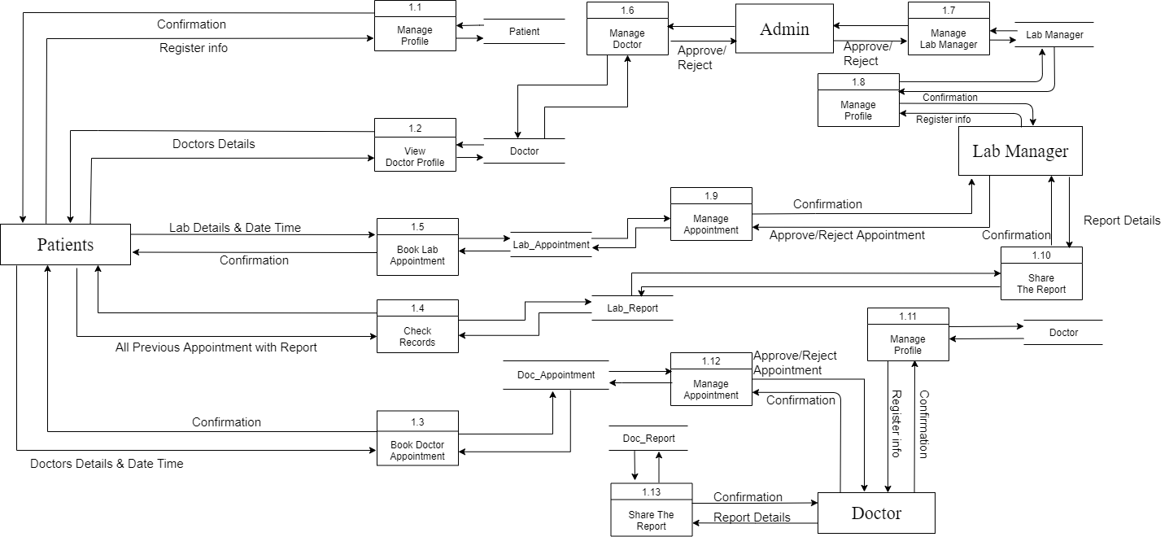

Slide 18
ER Diagram

Slide 19
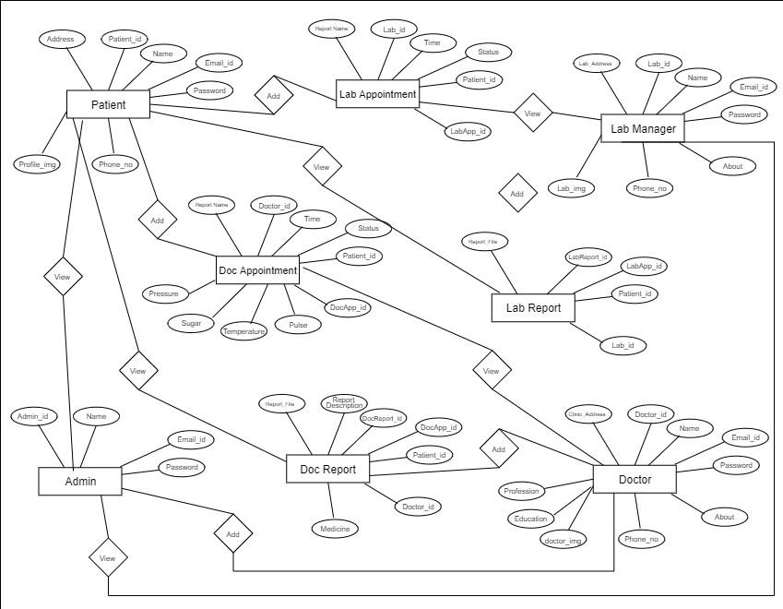

Slide 20
Advantages:-
Disadvantages:-
Time Saving.
Easy to Book Appointments.
Easy to Access Every Report.
Internet Connection is Required.
Do not use by the User who does not have experience in English Language and smartphone.
Very Complex to Explain.

Slide 21
Reference:-
https://reactnative.dev/docs/
https://docs.expo.dev/
The Complete React Native Course 2021 (https://youtu.be/ANdSdIlgsEw)

Slide 22
Upcoming features
AI program that Check patient health.
Patient and Doctor/Lab can Communicate through Video call or Chat.
Patient can buy the medicine through the app.
Patient get the notification of the daily medicine.
Added more language support to understand all users in App.

Slide 23
Conclusion
The Healthcare System is Very Helpful to Manage the Time of all users like Doctor, Lab manager and Patient. Also Doctor can see the Patient History Reports and Problems. Lab Manager also have easy to manage appointment and Upload the Reports.

